Slide 1
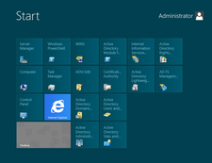
What’s new in Windows Server 2012?
Presentation by Daniel “3ICE” Berezvai
http://elte.3ice.hu/2014-15/WRS/

Slide 2
Also known as Windows Server 8
Basically it is the server side version of Windows 8.
It is the next version after Windows Server 2008 R2.
Came out on 2012. September 4.

Slide 3
Limitations
No Itanium processor support.
64-bit only
Some features need to be installed separately now.

Slide 4
User interface
Looks like Windows 8:
Metro
Tiles
Notable exception: Server Core

Slide 5
PowerShell
2100 brand new commandlets!
Up from the measly 200 cmdlets in the previous version.

Slide 6
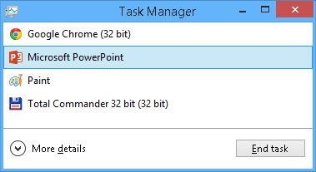
Task manager* *Forget CTRL+ALT+DEL, use CTRL+SHIFT+ESC
Ironically it looks like a massive downgrade at first:
But it gets better!
(→ See next two slides)

Slide 7
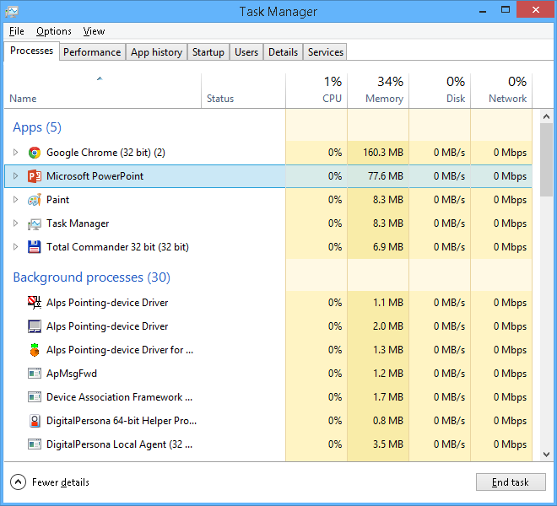
After clicking on More details:

Slide 8
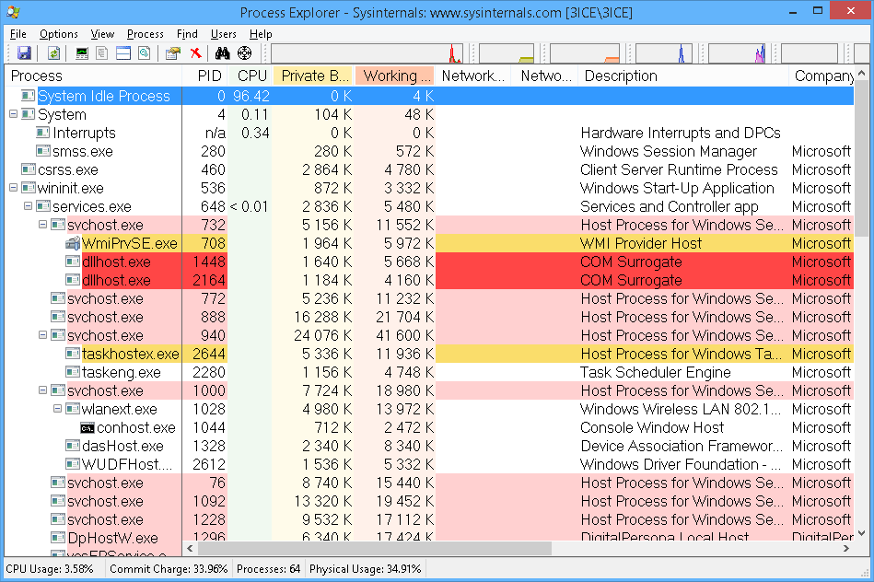
Still nowhere near as powerful as Process Explorer

Slide 9
Task Manager continued
Stronger yellow highlight for CPU and memory hogs
If you have more than 64 cores, you get a cool heatmap instead of individual graphs per core. (I don’t have 64 cores, so no screenshot — Google it!)
No more msconfig to disable Startup items
We use the task manager now.
I recommend using Autoruns instead (→ Next slide!)

Slide 10
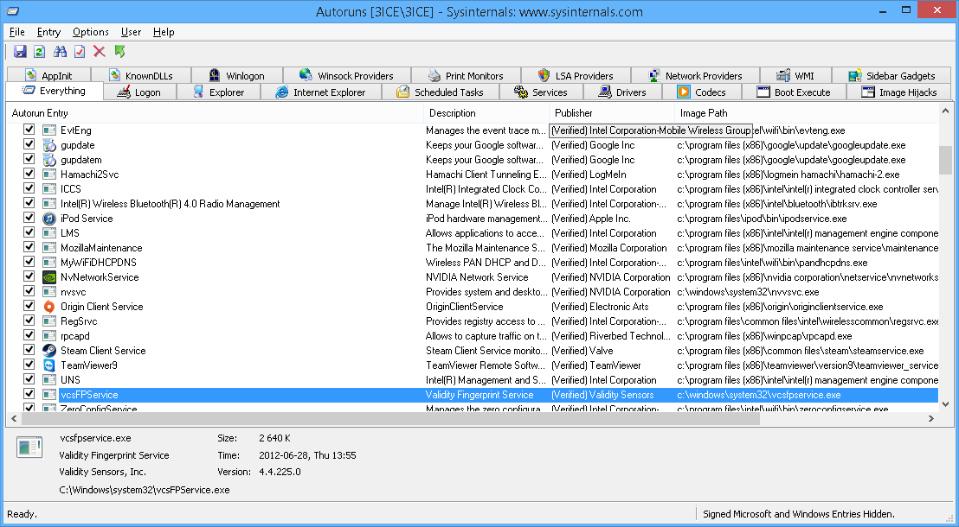
Autoruns

Slide 11
Install options
Multiple (Three) flavors:
Can switch between recommended console (Server Core) and newbie-friendly GUI variants without having to reinstall. (We saw this last week.)
Third variant: “Some GUI allowed”
MMC is okay, but no Internet Explorer, Windows Explorer or Desktop

Slide 12
IPAM (See presentation by […])
IP Address Management
Lets you administrate and monitor your DHCP- and DNS- servers.
Of course both IPv4 and IPv6 are supported.
See all IP address spaces
Reports
Audits
Management

Slide 13
AD — Active Directory
Old Install wizard replaced with a brand new server manager component
Improved ADAC (Active Directory Administrative Center)
AD Trash (for holding deleted items) has a proper GUI now.
Password policies can be even more fine grained. (Who on earth needs this level of control?)
Better virtualization support
Simplified GPO elevation

Slide 14
Hyper-V
Network virtualization
Big words: Multi-tenancy, Storage resource pools, cross-premise connectivity, Cloud-based saves, etc.
Limitations are less strict: Up to 64 cores, 1TB RAM, and 64TB hard drive per virtual machine. (Thanks to the new *.vhdx file format.)
1024 active virtual machines per host machine, 8k per failover cluster

Slide 15
ReFS
Resilient File System
Code name: “Protogon”
Safer storage, uses B-trees for storing metadata and file data both.
Maximum 16exa file size, 1jotta volume size, 32k letters long filename
Built-in resistance, allocation-on-write, 64bit checksums per file
CHKDSK is not needed to be run as often (or at all) thanks to this

Slide 16
ReFS is compatible with old APIs
Keywords: BitLocker, ACL (think chmod 777), USN journal, ReadDirectoryChangesW, symbolic links, junction points, volume mount points, reparse points, shadow copy, file ID, oplocks.
Storage spaces, virtualization, better data mirroring (damaged copies are automatically detected and replaced by a background process)
Storage pool replaces dynamic volumes. (Mirrored or striped)

Slide 17
ReFS is compatible* with old APIs
Except:
alternative data streams
Object ID (for Distributed Link Tracking)
Short (DOS 8+3) file names like “Progra~1” are not available
Per-file compression and encryption
Transactional NTFS (Transaction: like in databases)
Sparse files
Hard links, extended file attributes, disk quotas
Data deduplication is missing as well, but can be third party
Windows 7 and older operating systems cannot handle ReFS volumes either.

Slide 18
IIS 8
IIS 8.0 runs in Windows Server 2012
New features for example:
Separate CPU quotas per website
Application Initialization
Central SSL management
Scalability extends on several cores (for NUMA systems)

Slide 19
System requirements
1,4 GHz CPU, x64 only
512 MB RAM
32 GB HDD (More if you have lots of RAM, 16 GB or more)
Update is possible from Windows Server 2008 or later (WS2008 R2 for example)

Slide 20
Scalability
Maximum supported hardware:
64 physical CPUs
640 logical CPUs (230 is Hyper-V is on)
4TB RAM
64 clusters (for task transfer)

Slide 21
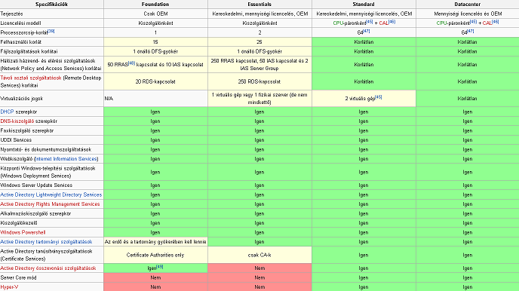
Editions
Foundation: OEM only, no server virtualization, no Server Core, no Hyper-V
Essentials:
25 user limit
Standard:
Many limita-
tions lifted
Datacenter:
Unlimited
See:
https://hu.wikipedia.org/wiki/Windows_Server_2012#Kiad.C3.A1sok
Or
https://en.wikipedia.org/wiki/Windows_Server_2012#Editions

Slide 22
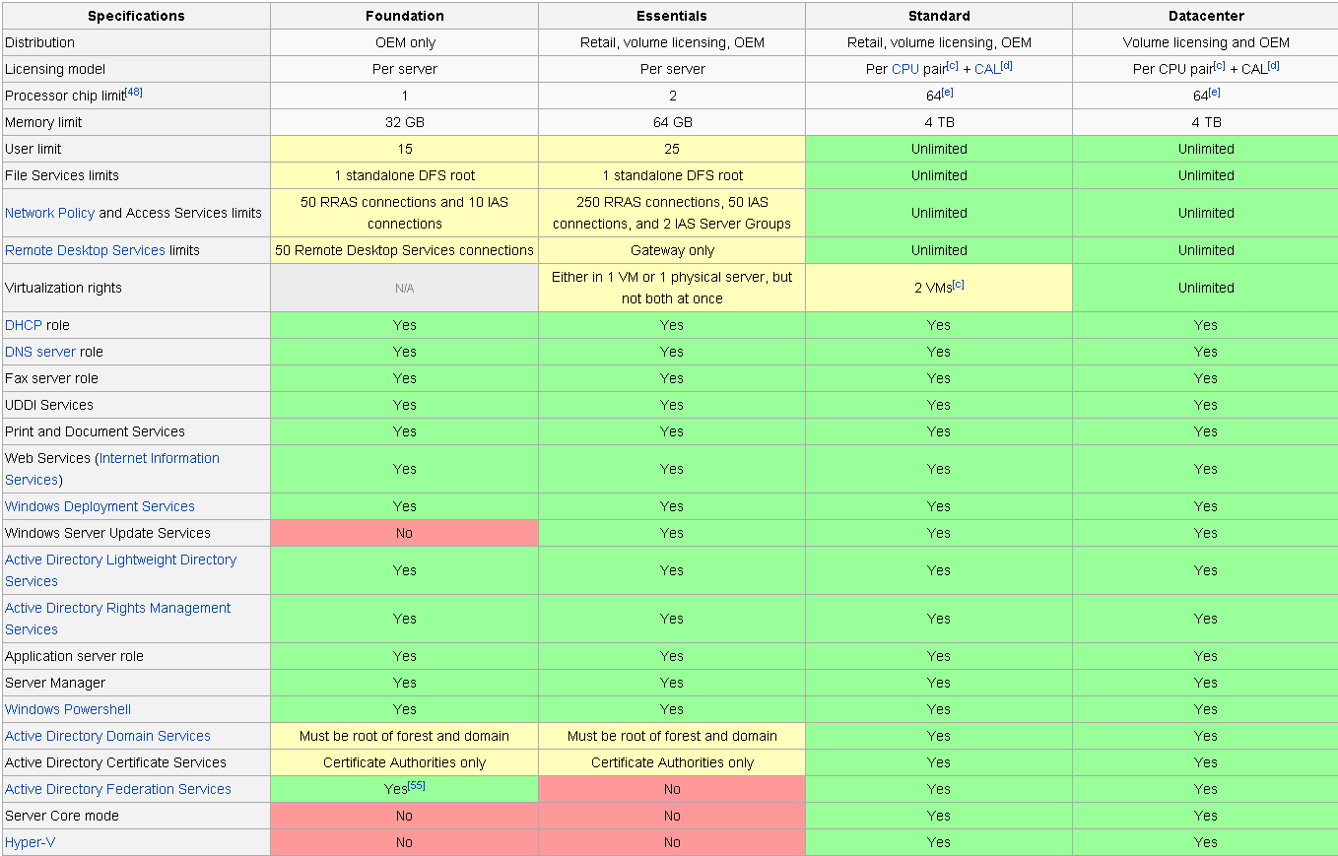
Same table in English:

Slide 23
Sources
First 22 slides from https://hu.wikipedia.org/wiki/Windows_Server_2012 (Translated by Daniel “3ICE” Berezvai, most screenshots by Daniel “3ICE” Berezvai — taken on a lookalike Windows 8 system, not the server.)
I also read all of this in preparation:
http://www.techrepublic.com/blog/10-things/10-cool-new-features-in-windows-server-2012-r2-essentials/
http://www.infoworld.com/article/2606748/microsoft-windows/108930-10-excellent-new-features-in-Windows-Server-2012-R2.html

Slide 24
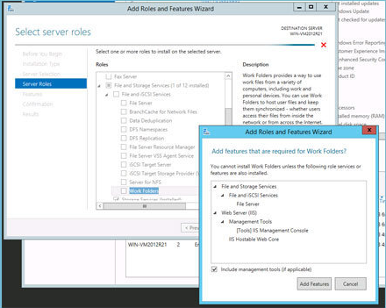
Work Folders
Notes:
Work Folders bring the functionality of Dropbox to corporate servers. Install this role on a Windows Server 2012 R2 system, and you get a fully functional, secure file replication service. The initial release will support only Windows 8.1 clients. Support for Windows 7 and iPad devices is promised for the future, with Android clients further down the list. Like Dropbox, Work Folders will keep copies of files on both the server and the client, performing sync operations whenever the client establishes a connection with the server.

Slide 25
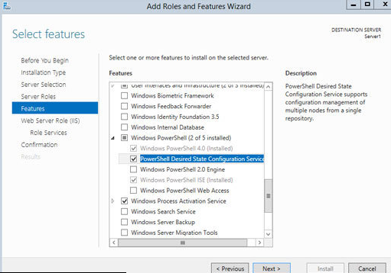
Desired State Configuration
Notes:
Maintaining configuration on lots of servers has been a thorn in the side of system administrators for as long as anyone has been running lots of servers. Many point solutions and countless custom in-house tools have been devised to accomplish the task. Now there is a feature built into Windows Server 2012 R2 that makes it possible to programmatically establish a baseline of roles and features, then monitor and update any system that doesn't match the desired state. Desired State Configuration requires PowerShell 4.0, which provides a number of new cmdlets to accomplish both the monitoring and the administration of specific states.

Slide 26
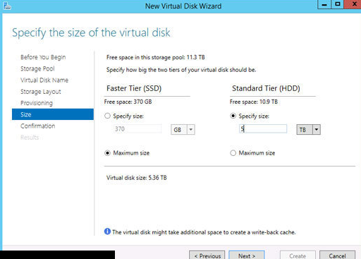
Storage Tiering
Notes:
This might be the single most exciting new feature in Windows Server 2012 R2. In essence, Storage Tiering is the ability to dynamically move chunks of stored data between different classes of storage, such as fast SSDs and slower hard drives. Many high-end storage systems have had automated tiering for years, but this is the first time you are able to do it at the operating system level. Microsoft uses a heat-map algorithm to determine which chunks of data are seeing the most activity and automatically moves the "hottest" chunks to the fastest tier. You can adjust the settings for how and when the data is moved using PowerShell.

Slide 27
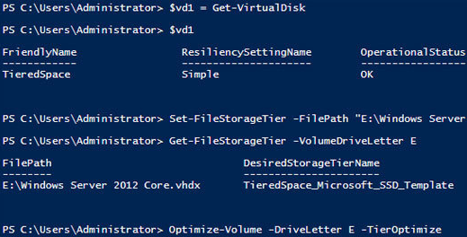
Storage Pinning
Notes:
Closely related to Storage Tiering is the ability to pin selected files to a specific tier. Pinning makes it possible to ensure that files you always want on the fastest storage, such as boot disks in a Virtual Desktop Infrastructure deployment, will never be moved to the slower storage tier. Otherwise, files that you always want to take advantage of SSDs might be moved to the HDD tier after some period of relative inactivity.

Slide 28
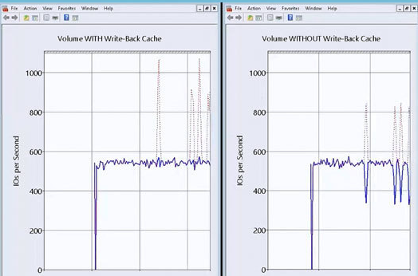
Write Back Cache
Notes:
When you create a new storage volume in Windows Server 2012 R2, you also have the option to enable something called the Write Back Cache. This feature sets aside an amount of physical storage, typically on a fast SSD, to use as a write cache to help smooth out the ups and downs of I/O during write-intensive operations. This can be seen in a typical database scenario where a large volume of disk writes may exceed the ability of the drive controller and disks to keep up. The cache would eliminate any pauses caused by an overwhelmed storage subsystem.

Slide 29
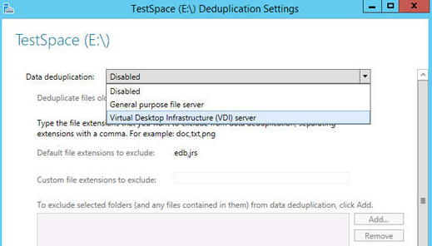
Deduplication on running VMs
Notes:
Data deduplication in Windows Server 2012 is a nice feature, but one thing it cannot do is deduplicate running virtual machines. That limitation is removed in Windows Server 2012 R2, albeit specifically for VDI (Virtual Desktop Infrastructure) deployments on SMB 3.0. That said, this new capability could greatly increase the overall effectiveness of deduplication for VDI implementations. As a side benefit, deduplication greatly improves boot performance of virtual desktops. In addition to storing the VMs on SMB 3.0 (required), Microsoft highly recommends using Scale-Out File Server on Windows Server 2012 or Windows Server 2012 R2. Cluster Shared Volumes are supported for high availability.

Slide 30
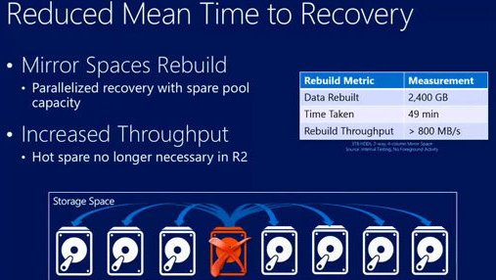
Parallel rebuild
Notes:
If you've ever had a disk fail in a RAID array, you know a disk rebuild can take many hours. And with more and more deployments of really large physical disks, the amount of time required to rebuild a drive will only get longer. Microsoft addressed the issue of lengthy CHKDSK checks in Windows Server 2012, which greatly reduced the time required to scan and repair a single disk. Windows Server 2012 R2 adds the ability to perform a parallel rebuild of a failed Storage Spaces drive, reducing the amount of time required by an order of magnitude. Demonstrations at TechEd showed a rebuild of a 3TB disk taking less than an hour.

Slide 31
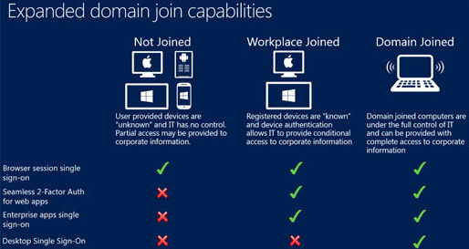
Workplace Join
Notes:
Windows Server 2012 R2 addresses the need to incorporate personal devices like iPads into the enterprise environment. At the simplest level is a new Web Application Proxy that allows you to provide secure access to internal corporate websites, including SharePoint sites, to any authorized user. One step further is a new capability called Workplace Join, which allows users to register personal devices with Active Directory and gain certificate-based authentication and single sign-on to enterprise applications and data. Standard tools like Group Policy apply here for controlling conditional access on either an individual or group basis.

Slide 32
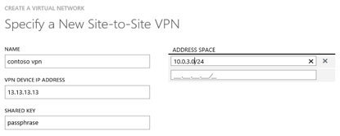
Multitenant VPN gateway
Notes:
Microsoft has added a number of new features to make it easier to provide secure communications between on- and off-premise networks. The new multitenant VPN gateway lets you implement site-to-site connectivity to multiple external sites via a single VPN link. This feature is aimed at both hosting providers and large organizations looking to implement connectivity with multiple sites or external organizations. Each site-to-site network connection require a separate gateway in Windows Server 2012, adversely impacting both cost and ease of implementation when more than a few connections are required for a single application. Windows Server 2012 R2 does away with this limitation.

Slide 33
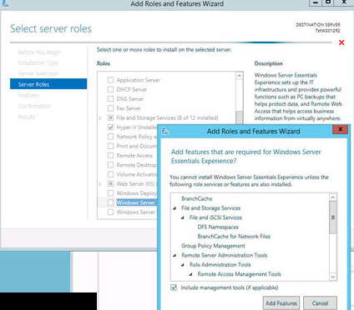
Windows Server Essentials role
Notes:
While this might not sound like a big deal, it has the potential to make life much easier for any organization with a geographically distributed network. With Windows Server 2012, you have to use a completely different installation source for Windows Server Essentials. For large organizations, this can impact both distribution strategy and configuration management. The Windows Server Essentials role in Windows Server 2012 R2 brings with it a number of other features -- including BranchCache, DFS Namespaces, and Remote Server Administration Tools -- that are typically implemented in remote office settings.

Slide 34
Sources
http://www.infoworld.com/article/2606748/microsoft-windows/108930-10-excellent-new-features-in-Windows-Server-2012-R2.html

