Slide 1
Chasing those perfect Hash functions…
by Daniel “3ICE” Berezvai
elte.3ice.hu/2013-2014-2/Alg2/GY/Alg2 GY 2 HF

Slide 2
Presentations are not allowed
“PowerPointos prezentációt erre a feladatra nem lehet készíteni, csak programot.”
I immediately thought – Lets make a presentation then!
Of course I wrote 6 apps too.

Slide 3
I don’t want to be a copy cat…
This assignment has been unchanged for years, I checked. Everyone did the same boring thing last year: (97*N1–79*N2+5*N3*N3–67*N4+99*N5–26*N6)%17
Or improvised only a little: √(A/4)+B/4−4*C+D+4*(4/E)−F
So I set out to do something unique instead. Excel macros, Focusing on speed, Cheating, Minimalist hashers that exclude more than half of the input characters, Coding it all in pure ANSI C for speed, Experimenting with different invariants, And more!

Slide 4
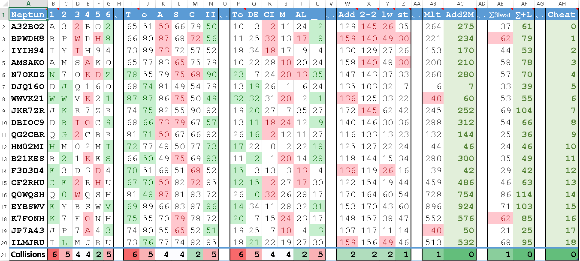
Excel: Finding min. collisions 3ICE-Minimal-Hash.xlsx

Slide 5
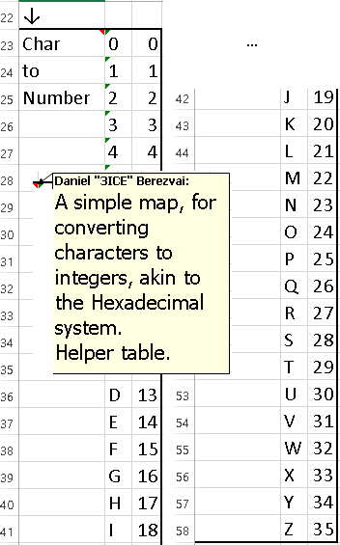
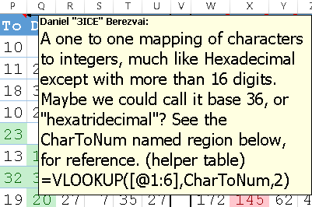
Excel demo points
I explain every column extensively via comments – If you are interested, download the spreadsheet from my website and read it for yourself:
Even documented the helper column!
Excel - Comments on every column

Slide 6
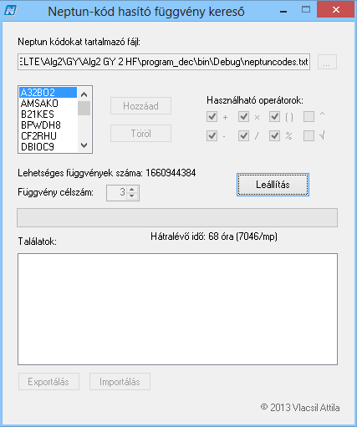
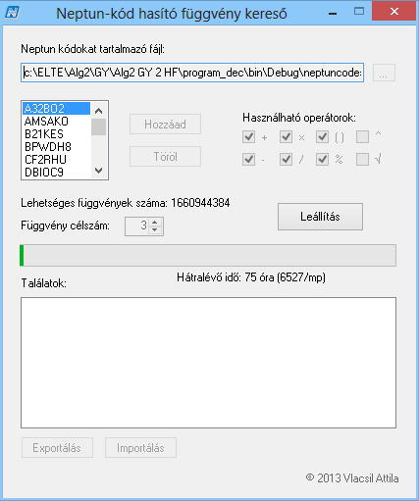
Competition – What I’m up against from last year…
This is a beautiful, fully
feature-complete app.
But it’s obviously
very, very slow…
Only does 7000 checks per second

Slide 7
What I achieved
Even my lazy random java implementation is relatively fast (1 minute to find 3 solutions)
That’s 1 340 120 checks per second!
This is on my quad core gaming Laptop of course, with 2 GPUs helping out… (CUDA assist technology)

Slide 8
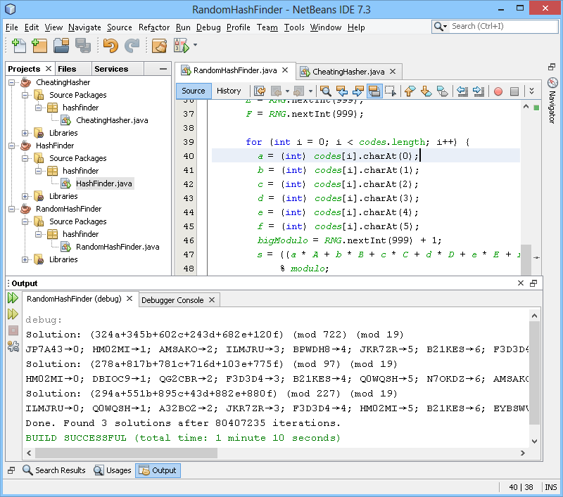

Slide 9
Finding 30 solutions in 11 minutes
Solution: (14a+72b+859c+89d+517e+660f) (mod 767) (mod 19)
Solution: (242a+454b+675c+732d+486e+685f) (mod 312) (mod 19)
Solution: (701a+407b+562c+707d+539e+946f) (mod 724) (mod 19)
Solution: (747a+732b+975c+316d+767e+701f) (mod 538) (mod 19)
Solution: (782a+940b+801c+267d+835e+405f) (mod 327) (mod 19)
Solution: (5a+525b+65c+431d+104e+802f) (mod 175) (mod 19)
Tested 100000000 random combinations.
Solution: (690a+932b+172c+533d+847e+199f) (mod 848) (mod 19)
Solution: (154a+505b+49c+170d+304e+66f) (mod 158) (mod 19)

Slide 10
At this point it has checked over 200 million combinations
Solution: (753a+377b+866c+734d+226e+65f) (mod 214) (mod 19)
Solution: (422a+104b+103c+864d+707e+44f) (mod 29) (mod 19)
Solution: (405a+4b+537c+235d+452e+487f) (mod 544) (mod 19)
Tested 200000000 random combinations.
Solution: (857a+567b+630c+914d+909e+448f) (mod 541) (mod 19)
Solution: (44a+147b+424c+157d+403e+664f) (mod 81) (mod 19)
Solution: (594a+882b+610c+148d+53e+352f) (mod 733) (mod 19)
Solution: (95a+826b+173c+124d+756e+210f) (mod 826) (mod 19)
Solution: (501a+913b+736c+580d+397e+412f) (mod 5) (mod 19)

Slide 11
We are half way done after only 5 minutes of work.
Solution: (381a+395b+206c+733d+359e+248f) (mod 173) (mod 19)
Solution: (481a+29b+482c+303d+490e+503f) (mod 290) (mod 19)
Tested 300000000 random combinations.
Solution: (768a+154b+580c+135d+279e+332f) (mod 699) (mod 19)
Solution: (518a+591b+493c+622d+534e+556f) (mod 560) (mod 19)
Solution: (972a+386b+519c+686d+443e+610f) (mod 107) (mod 19)
Solution: (66a+377b+83c+377d+735e+980f) (mod 863) (mod 19)
Solution: (816a+411b+87c+978d+757e+705f) (mod 567) (mod 19)
Solution: (866a+43b+921c+0d+422e+310f) (mod 793) (mod 19)

Slide 12
Finding 30 solutions took 11 minutes, with over 500 million generated hash functions checked
Tested 400000000 random combinations.
Solution: (126a+208b+625c+509d+165e+976f) (mod 532) (mod 19)
Solution: (288a+492b+640c+178d+688e+392f) (mod 127) (mod 19)
Solution: (830a+447b+859c+222d+42e+41f) (mod 966) (mod 19)
Solution: (772a+643b+255c+962d+732e+947f) (mod 50) (mod 19)
Solution: (325a+77b+494c+152d+976e+308f) (mod 326) (mod 19)
Tested 500000000 random combinations.
Solution: (552a+854b+857c+426d+886e+262f) (mod 145) (mod 19)
Done. Found 30 solutions after 520563179 iterations.
BUILD SUCCESSFUL (total time: 11 minutes 56 seconds)

Slide 13
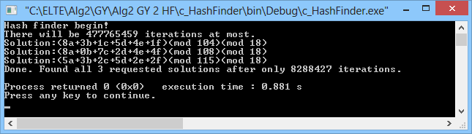
Even faster solve speed in a pure ANSI c implementation
That is 9 407 976 solutions
tested per second

Slide 14
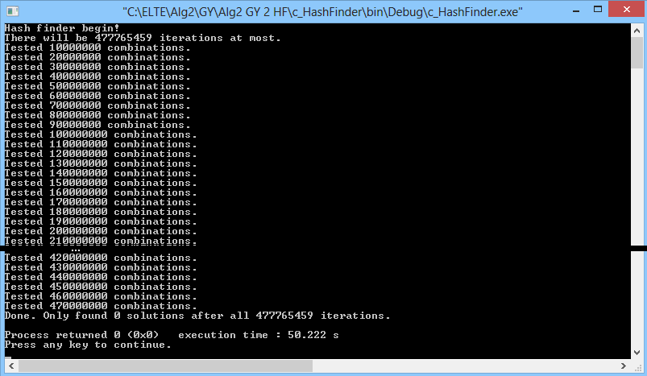
Here is a failed run on a small pool of possible combinations
(477 million tested in 50 seconds… ≈10 million per second)
This is of course on the
full code pool (19), while
the previous screenshot
shows a reduced pool
of just 18 codes hashed.

Slide 15
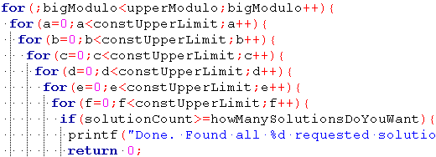
How did I code the C version? Unconventionally…
It all starts with a 7 levels deep nested loop…
(See the code in main.c for commented version)

Slide 16
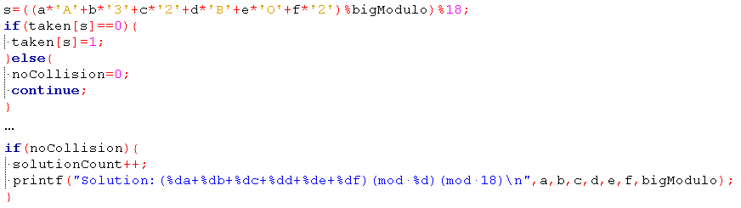
Main program logic showing just one code being checked

Slide 17
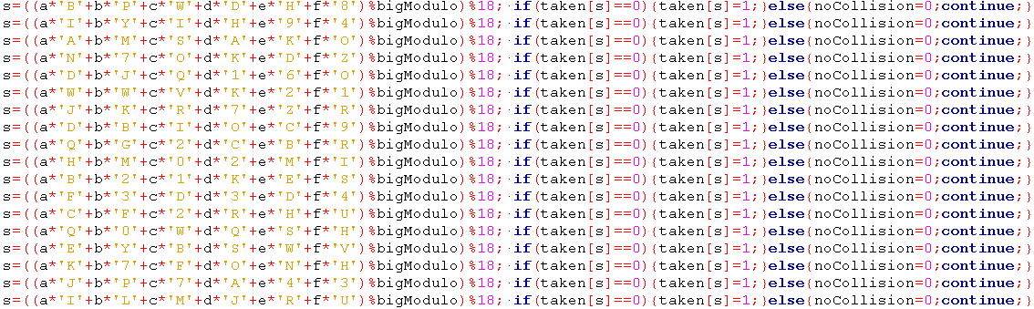
A “loop” without iteration overhead or array pointer arithmetic, using hardcoded values:

Slide 18
Repeat code would look so much better in a loop, wouldn’t it? But I’d lose more performance!
This would be the nested loop’s 8th level. Even 7 is far too deep, we are only supposed to use 1.

Slide 19
Computation time goes up ridiculously fast!
This is worse than n²! Exponential doesn’t compare…
16 or less codes? <1 second!
17 codes: 1 minute
18 codes: 50 minutes
19 codes: 70+ hours!

Slide 20
Therefore, some groups had an easier job than others :)
Group 7 were only given 13 codes. They had an easy time, spending 1 second to calculate all their required solutions.
Group “E” had 18 codes to work with, their apps were done in an hour.
Group 8 – my group – had 19 codes, however. That means I’d have to leave my computer on for days if I wanted to calculate solutions the usual way… Except I didn’t have that kind of time! I only started working on this project the previous night and finished just before the deadline. Also, I’d be burning quite a bit of life out of my CPU and GPUs if I ran them at 100%, or at least near-peak performance for days. So I had to improvise.
The end.

